Slide 1
Introduction to MAP-REDUCE
Notes:
‹#›

Slide 2
Agenda
What is MapReduce
Use cases of MapReduce
MapReduce Logical dataflow – Input split, record reader, Mapper, Sort, Shuffle, Reducer, Output
MapReduce Design and Execution
‹#›
Notes:
‹#›

Slide 3



Apache Hadoop Core Components
HDFS (storage) - stores data in chunks by splitting it into 64MB each block, is from the “Infrastructural” point of view
MapReduce (processing) - is from the “Programming” aspect
A Java framework for processing parallelizable problems across huge datasets, using commodity hardware, in a distributed environment
Google has used it to process its “big-data” sets (~ 20,000 PB/day)
Can be implemented in many languages: Java, C++, Ruby, Python etc.
‹#›
Notes:
‹#›

Slide 4
Problem statement: To count the frequency of words in a file
Input file name : secret.txt and has just 2 lines of data. Contents of the file: this is not a secret if you read it
it is a secret if you do not read it
THE EXPECTED OUTPUT AS BELOW
This 1
is 2
not 2
a 2
secret 2
if 2
you 2
do 1
read 2
it 2
‹#›
Notes:
‹#›

Slide 5

2 stage approach using MAP & REDUCE
THE MAP STAGE
this is not a secret if you read it
(The above is the first line in the input file)
I am RECORD READER
I process one line at a time from the input file and produce 2 outputs
Output 1 (a number) Output 2 (entire line)
‹#›
Notes:
‹#›

Slide 6
Output of the record reader
output 1 (A number) output 2 (The entire line)
Output 1 is always called as KEY
Output 2 is always called as VALUE
(The same naming conventions would be used throughout the discussion hereafter)
KEY : 0 (file offset)
VALUE : this is not a secret if you read it (first line)
‹#›
Notes:
‹#›

Slide 7
WHAT IS FILE OFFSET ?
It’s a new file
Which is almost used for nothing !
Consider this file having 2 lines
Each character in the file occupies one byte of data
First character of line one starts at location 0
Number of characters in the first line
It’s : 4 space : 1 (total 5)
a : 1 space : 1 (total 2)
new : 3 space : 1 (total 4)
file : 4 new line : 1 (total 5)
Total of 16 characters or 16 bytes. The next line would begin at location 17. File offset for next line is 17
‹#›
Notes:
‹#›

Slide 8

Record reader’s o/p to mapper
Output of the record reader is fed to the MAPPER
Mapper can process only one key & value at a time
Produce output in key, value pairs based on what its programmed to perform
0 (KEY) this is not a secret if you read it (VALUE)
I’m the MAPPER
I can be PROGRAMMED !
I accept only one key value pairs as input and produce key-value-pairs as output
‹#›
Notes:
‹#›

Slide 9
Programming the mapper
Mapper can be programmed based on the problem statement
The input is a key value pair (file offset, one line from file)
0,this is not a secret if you read it
In the word count problem we shall program the mapper to do the following
Step1 : Ignore the key (file offset)
Step 2: Extract each word from the line
Step 3: Produce the output in key value pairs where key is each word of the line and value as 1 (integer/a number)
‹#›
Notes:
‹#›

Slide 10

Output of the mapper
0,this is not a secret if you read it
this 1
is 1
not 1
a 1
secret 1
if 1
you 1
read 1
it 1
‹#›
Notes:
‹#›

Slide 11
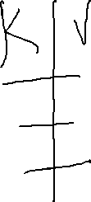


The sort operation
(This happens in the memory of the mapper machine)
Output of the mapper is fed into the sorter which sorts the mapper output in ascending order of the KEYS ! (lexicographic ordering or dictionary ordering since the keys are of string type)
Consider the simple example
SORTER
Cathy 34 Alice 10
Alice 10 Bob 89
Bob 89 Cathy 34
Note : Sorter can be reprogrammed (overridden) to sort based on values if required. Its called the sort comparator.
‹#›
Notes:
‹#›

Slide 12
Input to the sort phase
this 1
is 1
not 1
a 1
secret 1
if 1
you 1
read 1
it 1
it 1
is 1
a 1
(keys not sorted) (partial output of the mapper is shown here)
‹#›
Notes:
‹#›

Slide 13
Output of the sort phase
a 1
a 1
do 1
if 1
if 1
is 1
it 1
it 1
it 1
not 1
not 1
read 1
read 1
secret 1
‹#›
Notes:
‹#›

Slide 14


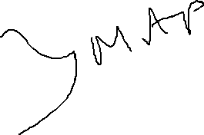
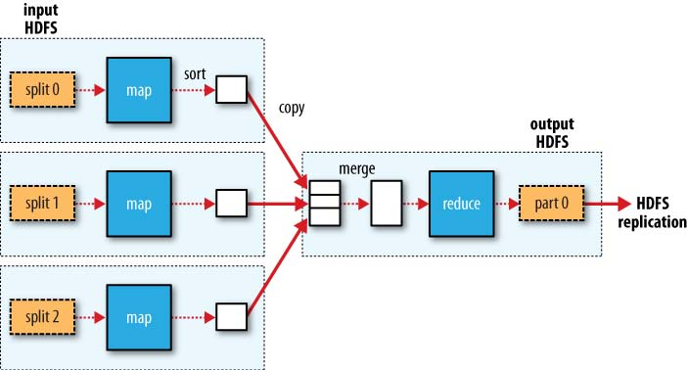





REDUCE stage
It has 3 sub-stages - merge, shuffle and reducer operation
The output of the several mapper's will be merged into a single file at reduce stage. This happens in the reducer machine.
‹#›
Notes:
‹#›

Slide 15

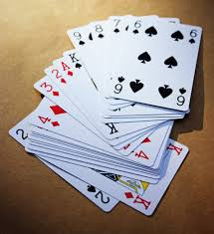


Shuffle/aggregate phase in REDUCE stage
Shuffling is a phase where duplicate keys from the input are aggregated.
Consider the simple example
Input is key value pairs (contains duplicate keys)
Output is a set of key value pairs without duplicates
Key value Key value
Apple 2 Apple 2, 4
Apple 4 Mango 1
Mango 1 Orange 11, 06
Orange 11
Orange 06
SHUFFLER
‹#›
Notes:
‹#›

Slide 16
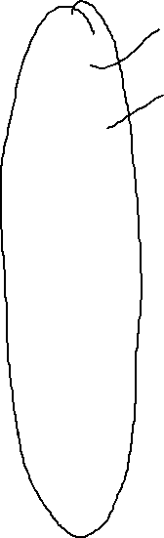

Shuffle operation at the reduce stage
a 1
a 1 a 1, 1
do 1 do 1
if 1 if 1,1
if 1 is 1,1
is 1 it 1,1
is 1
it 1
it 1
SHUFFLER
‹#›
Notes:
‹#›

Slide 17

The REDUCER operation in REDUCE stage
Reducer accepts the input from the shuffle stage
Reducer produces output in key value pairs based on what it is programmed to do as per the problem statement
‹#›
Notes:
‹#›

Slide 18

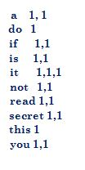

Programming the reducer
Output of the shuffle is the input to the REDUCER
Reducer can handle only one key value pair at a time
Step1: Input to the reducer is a 1, 1
Step2: The reducer must add the list of values from the input i.e
sum=1+1 = 2
Step3: Output the key and sum as output key, value pairs to an output file. The o/ would look like a 2
Step 4: Repeat the above operations (1,2&3) for entire input
‹#›
Notes:
‹#›

Slide 19
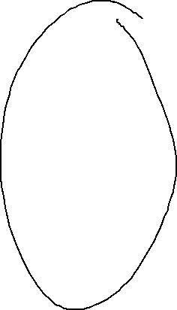

Final output of the reducer
Reducer input Reducer output (final o/p)
a 2
do 1
if 2
is 2
it 3
not 2
read 2
secret 2
this 1
you 2
‹#›
Notes:
‹#›

Slide 20
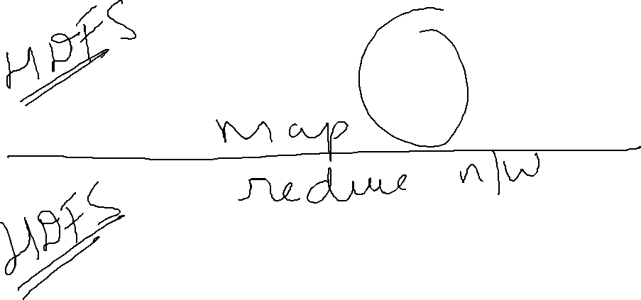



Everything in a nutshell
Input file processed by RECORD READER o/p goes to MAPPER & its o/p is sorted
‹#›
Final o/p file REDUCER SHUFFLE MERGE
Notes:
‹#›

Slide 21
ANAGRAM PROBLEM USING MAP REDUCE
What is anagram ?
MARY is a word and ARMY is another word which is formed by re arranging the letters in the original word MARY
Hence MARY and ARMY are anagrams
POOL and LOOP are anagrams. There could a lot of such examples.
‹#›

Slide 22
Problem statement
To identify and list all the anagrams found in a document. Eg A book (a novel)
Input file name : sample.txt (a file in text format) and has 2 lines in the file.
File contents: mary worked in army
the loop fell into the pool
Expected output : (must contain all the anagrams)
mary army
loop pool
‹#›

Slide 23
Programming the mapper
Mapper is programmed do the following
Step 1: Ignore the key from the record reader
Step 2: Split the words in the value (the full line)
mary works in army
[mary] [works] [in] [army] (the line is split)
Step 3: sort each word in dictionary order (lexicographic ordering)
mary after sorting would become amry
Step 4: Output the sorted word as key and original word as value . The sample output of mapper would look like
KEY VALUE
amry mary
Step 5: Repeat the above steps for all the words in the line
‹#›

Slide 24
Output of the record reader
This is going to the be output of the record reader after reading the first line of the file
Contents of the file : mary worked in army
loop fell into the pool
KEY VALUE
file offset entire line of the file
0 mary worked in army
The above (key-value pair) is now going to be fed into the mapper as an input.
‹#›

Slide 25
Output of the mapper after processing the entire file
KEY VALUE
amry mary
dekorw worked
in in
eht the
amry army
loop loop
efll fell
inot into
eht the
loop pool
‹#›

Slide 26
Output after sorting the keys
KEY VALUE
amry mary
amry army
dekorw worked
eht the
eht the
in in
inot into
loop loop
loop pool
efll fell
‹#›

Slide 27
Output after shuffling the keys (aggregation of duplicate keys)
KEY VALUE
amry mary, army
dekorw worked
eht the,the
in in
inot into
loop loop, pool
efll fell
‹#›

Slide 28

Observation and inference
KEY VALUE
amry mary, army
dekorw worked
eht the,the
in in
inot into
loop loop, pool
efll fell
ANY BULBS LIGHTING UP ?
‹#›

Slide 29
LOOK CLOSER !
There are some keys with more than one value. We need to only look at such key, value pairs
amry mary ,army
eht the , the
loop loop , pool
‹#›

Slide 30
Logic to list the anagrams
amry mary ,army
eht the,the
loop loop,pool
Problem : We need to only print the values belonging to keys “amry” and “loop” since only their values qualify for anagrams.
We need to ignore the values belonging to the keys “eht” since its corresponding values do not qualify for being anagrams.
‹#›

Slide 31
How to ignore the non anagram values ?
amry mary ,army
eht the ,the
loop loop, pool
We need to program the following into the reducer
Step 1: Check if the number of values are > 1 for each key
Step 2: Compare the first and second value in the values list for every key, if they match, ignore them.
key val1 val2
eht the the
Step 3: If the values don’t match in step 2. Compose a single string comprising of all the values in the list and print it to the output file. This final string is the KEY and value can be NULL (do not print anything for value)
KEY = “mary army” VALUE =“ “
Step 4: Repeat the above steps for all the key value pairs input to the reducer.
‹#›

Slide 32
Final output of the reducer
mary army
loop pool
The above output is for the case of a file with just 2 lines of data.
What if the file is 640MB in size ?
How does map reduce help in speeding up the job completion ?
‹#›

Slide 33
HOW DOES MAP REDUCE SPEED UP THE PROCESSING ?
What is the input file used in this example is 640MB instead of just containing 2 lines ?
The HADOOP framework would first split the entire file into 10 blocks each of 64MB
Each 64MB block would be treated as a single file
There would be one record-reader and one mapper assigned to each such block
Output of all the mappers would finally reach the reducer (one reducer is used by default) however we can have multiple reducers depending on degree of optimization required
‹#›

Slide 34
Why MapReduce?
Scale out not scale up: MR is designed to work with commodity hardware
Move code where the data is: cluster have limited bandwidth
Hide system-level details from developers: no more race condition, dead locks etc
Separating the what from how: developer specifies the computation, framework handles actual execution
Failures are common and handled automatically
Batch processing: access data sequentially instead of random to avoid locking up
Linear Scalability: once the MR algorithm is designed, it can work on any size cluster
Divide & Conquer: MR follows Partition and Combine in Map/Reduce phase
High-level system details: monitoring of the status of data and processing
Everything happens on top-of a HDFS
‹#›
Notes:
‹#›

Slide 35
Use case of MapReduce?
Mainly used for searching keywords in massive amount of data
Google uses it for wordcount, adwords, pagerank, indexing data for Google Search, article clustering for Google News
Yahoo: “web map” powering Search, spam detection for Mail
Simple algorithms such as grep, text-indexing, reverse indexing
Data mining domain
Facebook uses it for data mining, ad optimization, spam detection
Financial services use it for analytics
Astronomy: Gaussian analysis for locating extra-terrestrial objects
Most batch oriented non-interactive jobs analysis tasks
‹#›
Notes:
‹#›

Slide 36
Summary
Flow of map reduce using an example of word count
Anagram problem using map reduce
Why map reduce
Use cases of map reduce
‹#›
Notes:
‹#›

